Slide 1
School Project
By Group A
Zaw Thu Htet
May Phyo Thu
25.10.2022
(Tuesday)

Slide 2
Outlines
Introduction
Aim and Objectives
Flow Chart
Key Features of School Project
Experimental Results of the Project
Conclusion

Slide 3
Project Partition of Team A
Zaw Thu Htet
Student and Teacher Model & View
Section Model and View
Subject Model and View
Attendance
Daily Attendance, Leave, Total Attendance
Total Exam Result
May Phyo Thu
Student and Teacher Model & View
Section Model and View
Subject Model and View
Question Model and View
Exam Model and View

Slide 4
Introduction
This project is an odoo-based system which will use as a platform for interaction between student and teachers.
The main objective of this project is to computerize the paperwork in the system and automate the work.
By doing this system, it will reduce the time for storing any data in the system.
In this system, daily school activities like Student registration, Assign Teachers with Subject, Exam Question, Exam Result and leave management system are processed.

Slide 5
Aim and Objectives
To build an odoo ERP system to manage the different school activities
To facilitate distribution process of courses and classes for teachers
To facilitate exam questions and result of entry process for students by teachers
To make a virtual community between the members of educational process.

Slide 6
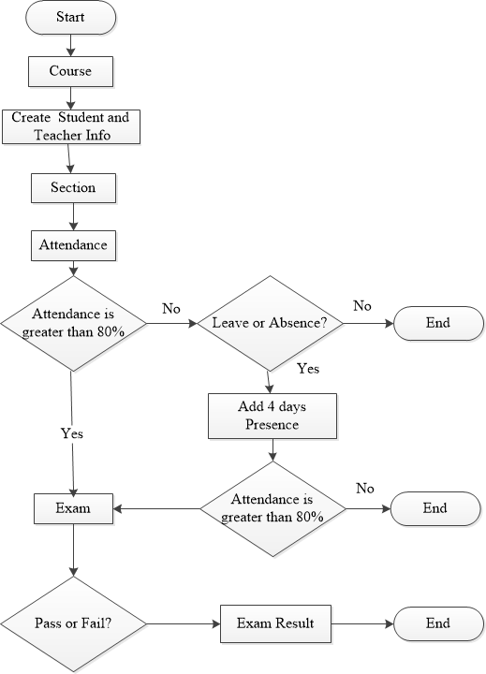
Flow Chart
Figure 1: Flow chart of the project

Slide 7

Key Features of School Project
01
Profile System
02
Course Routine Schedule
03
Attendance System
04
Question and Exam Marks Management

Slide 8
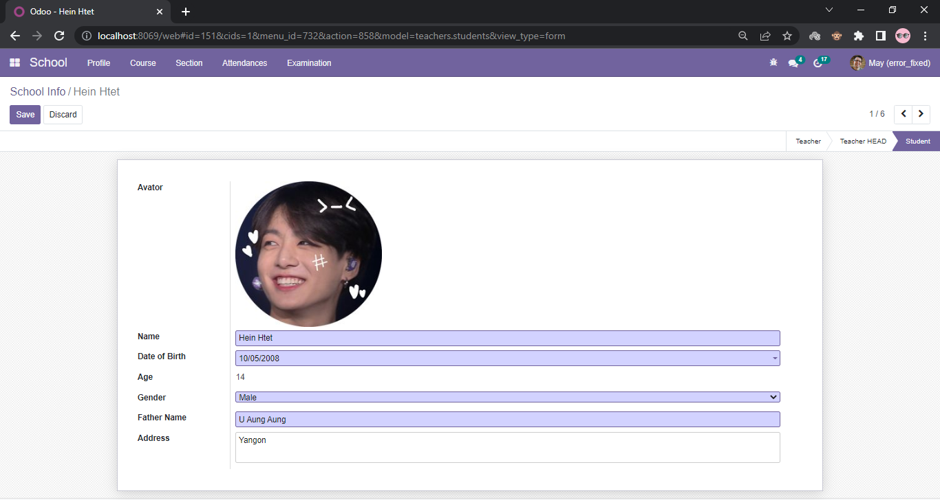
Experimental Result of the System
Create a New Student

Slide 9
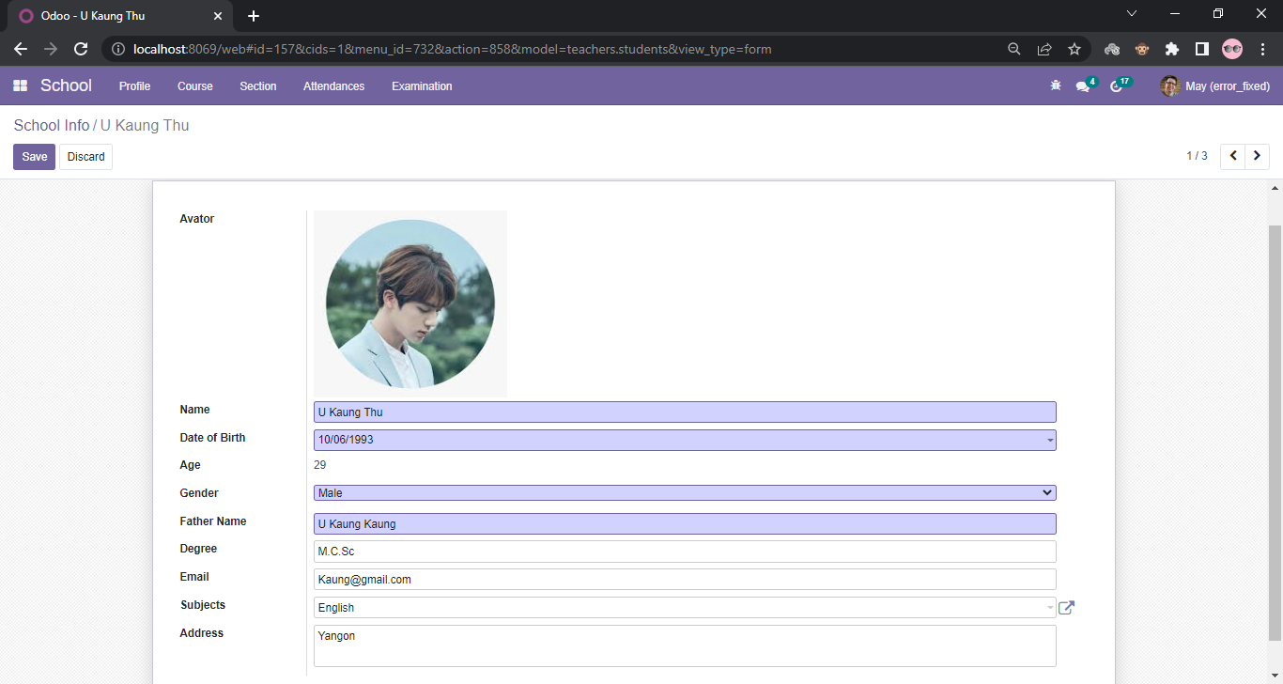
Cont’d
Create a New Teacher

Slide 10
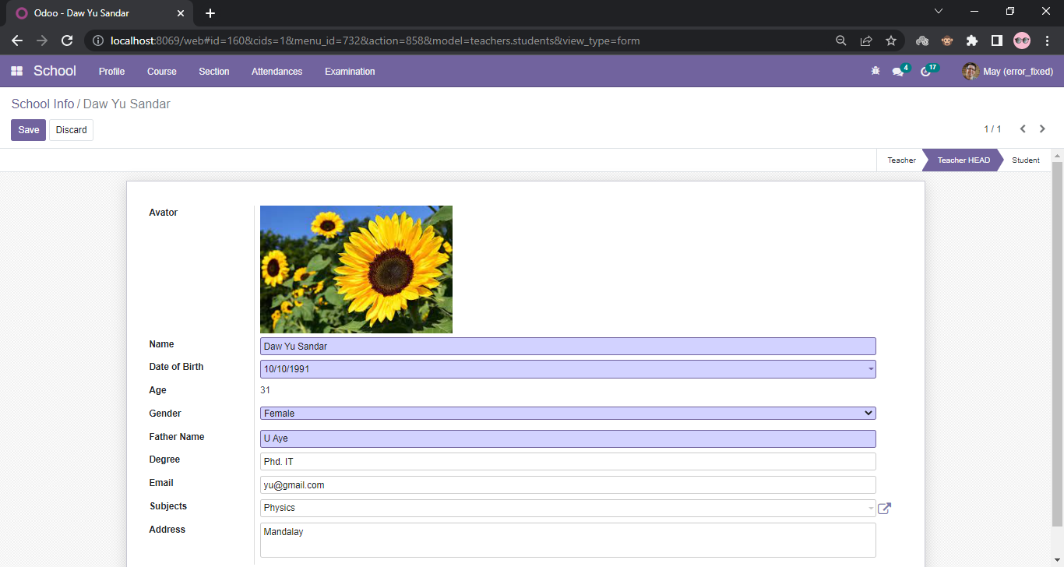
Cont’d
Create a New Head Teacher

Slide 11
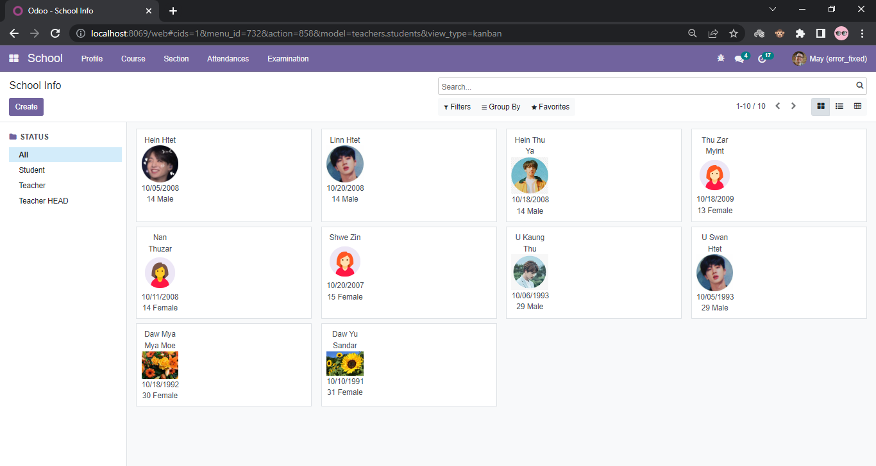
Cont’d
Check School info of Student, Teacher or Teacher HEAD

Slide 12
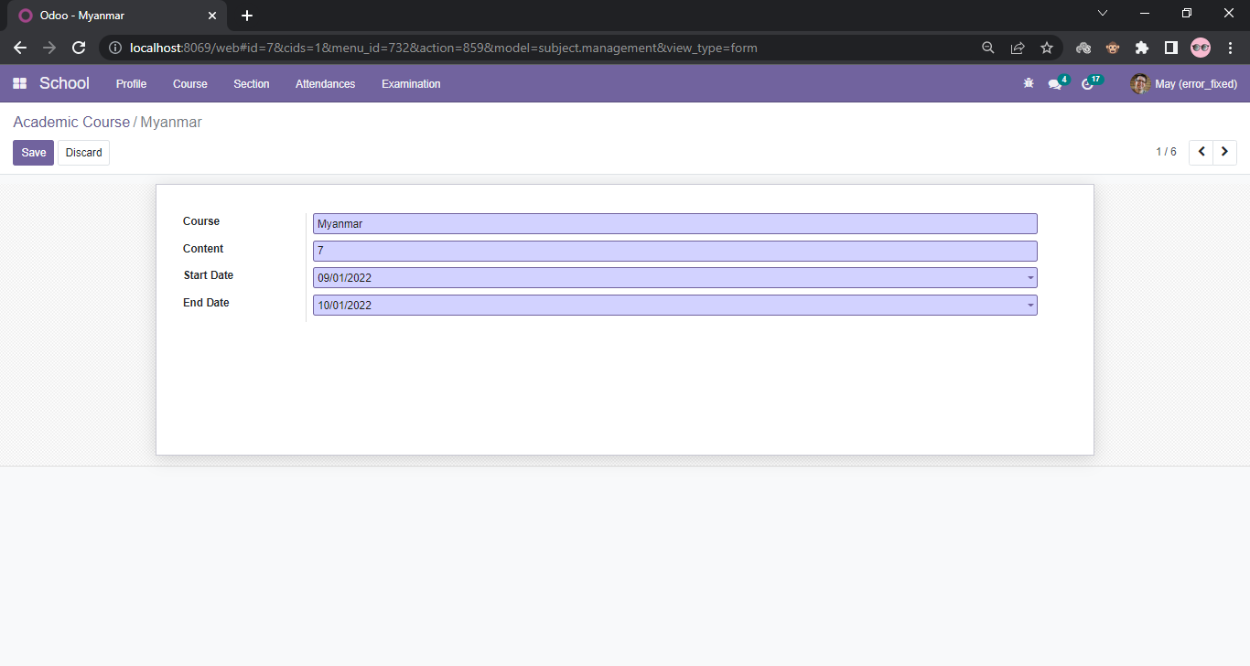
Cont’d
Create New Academic Course

Slide 13
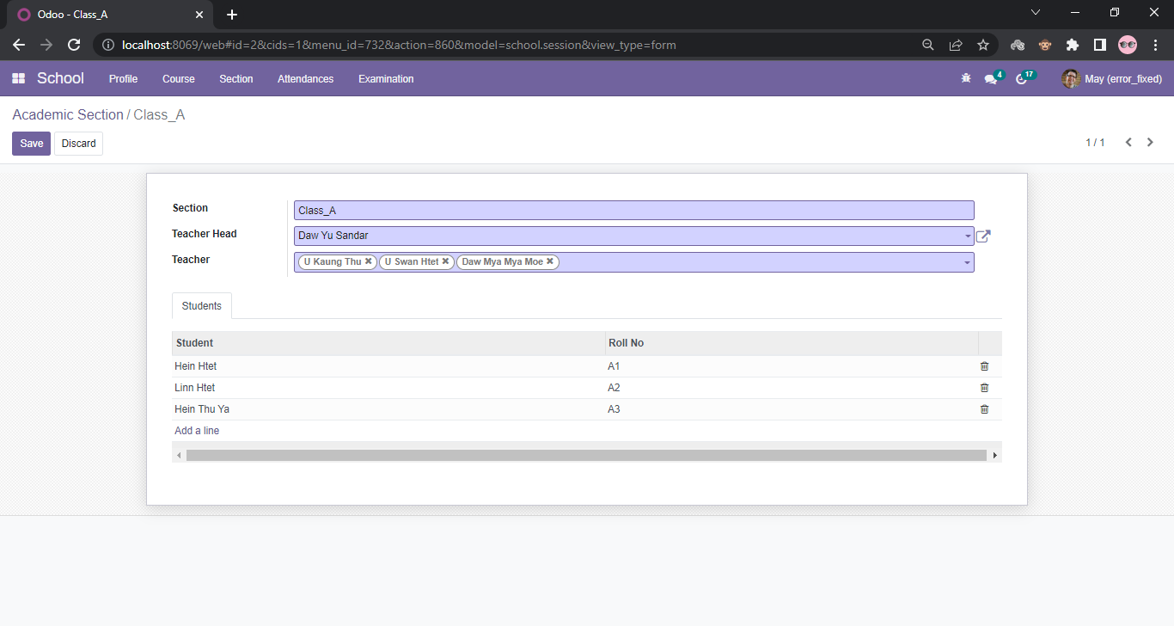
Cont’d
Create New Academic Section

Slide 14
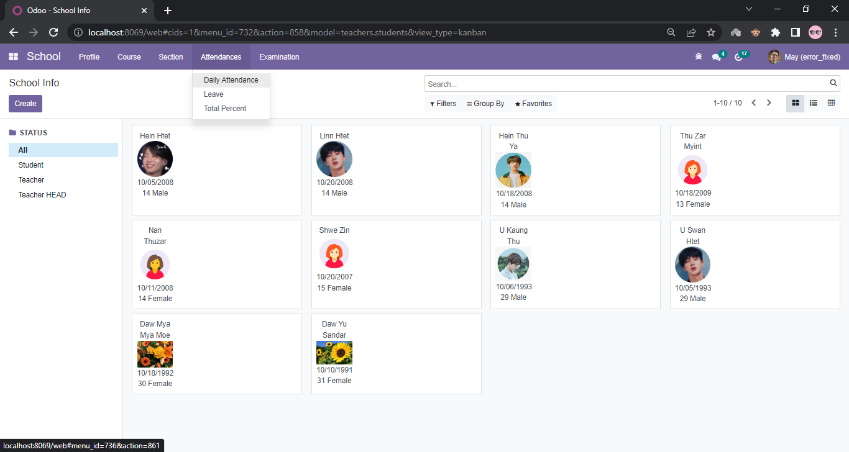
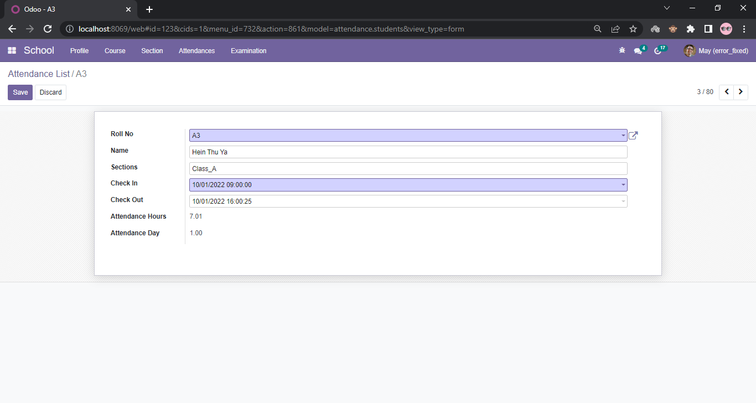
Cont’d
Create Daily Attendance

Slide 15

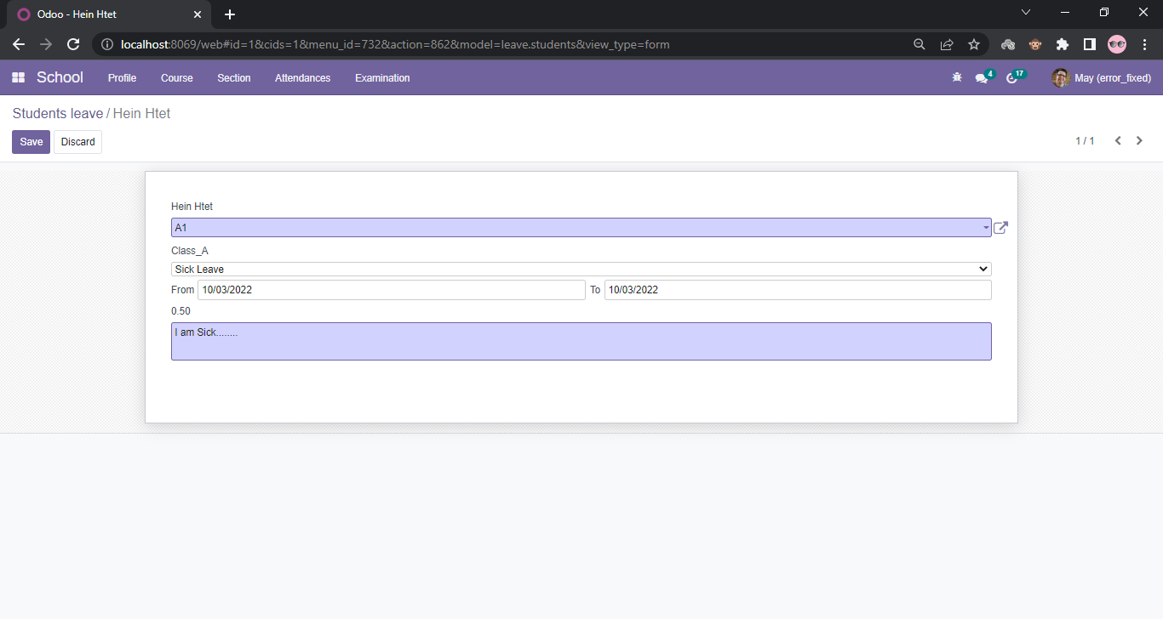
Cont’d
Create Leave for Student

Slide 16

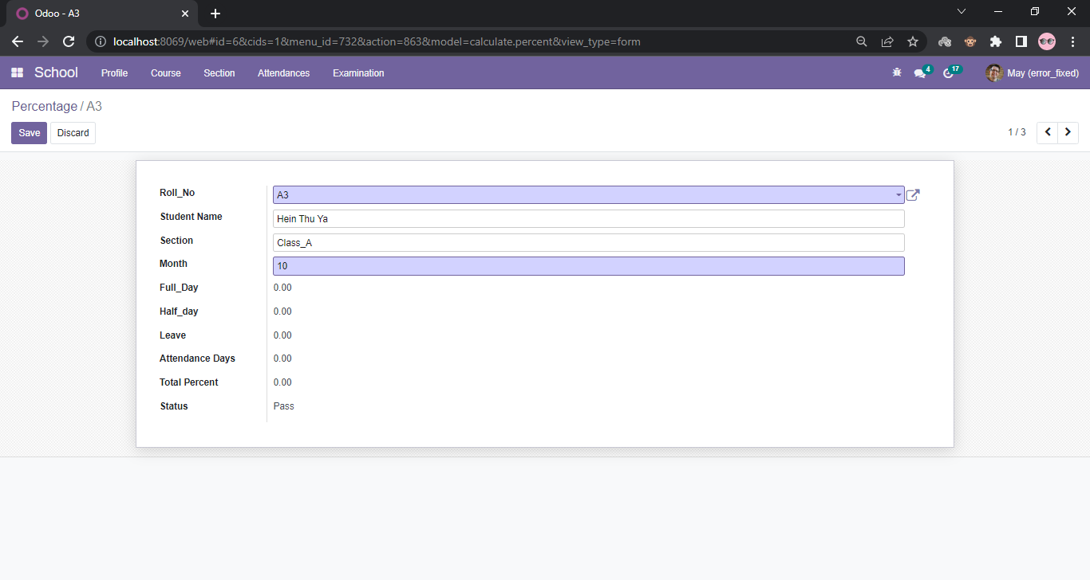
Cont’d
Create Total Attendance Percent of Student

Slide 17
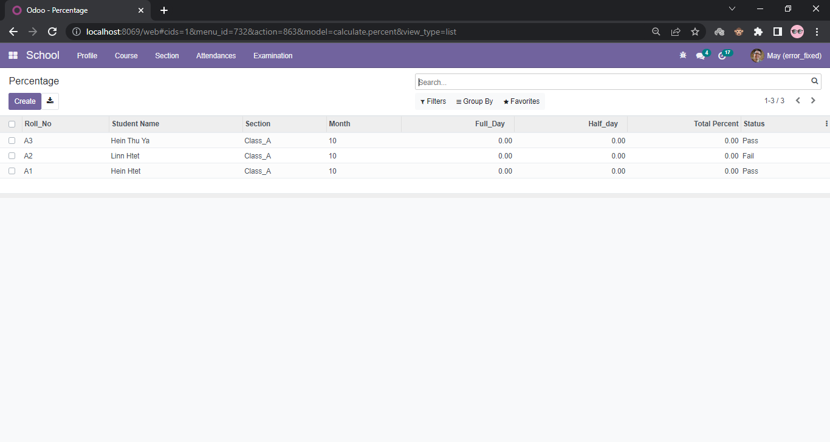
Cont’d
Check Total Percentage of Student List

Slide 18
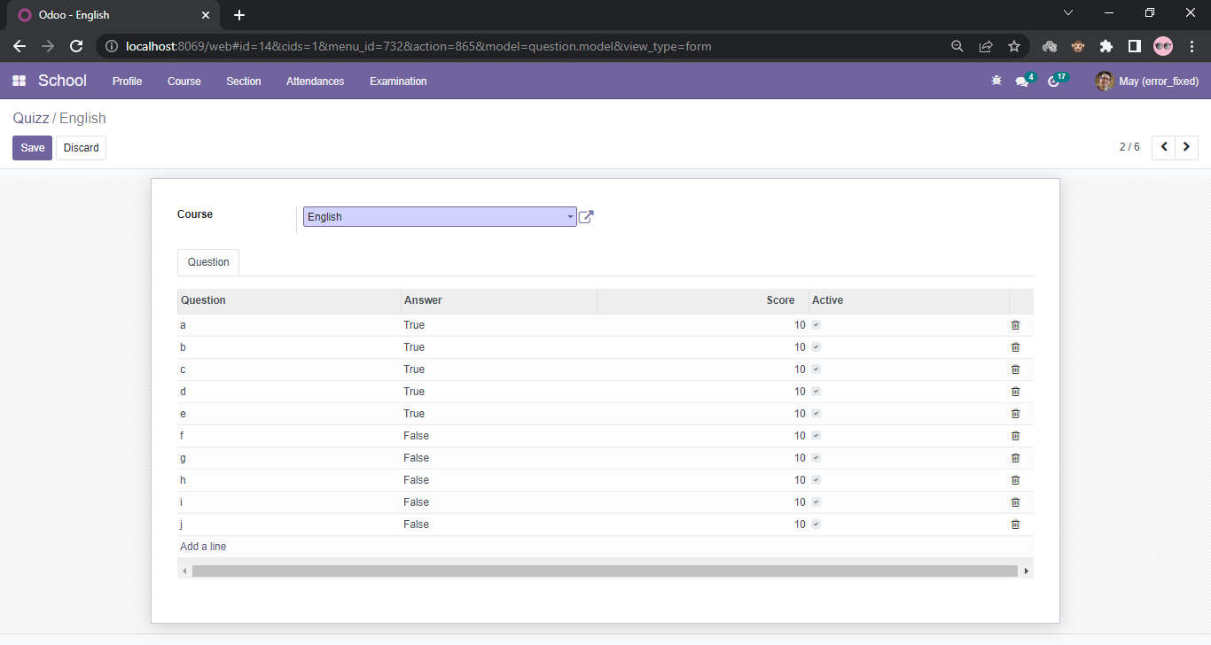
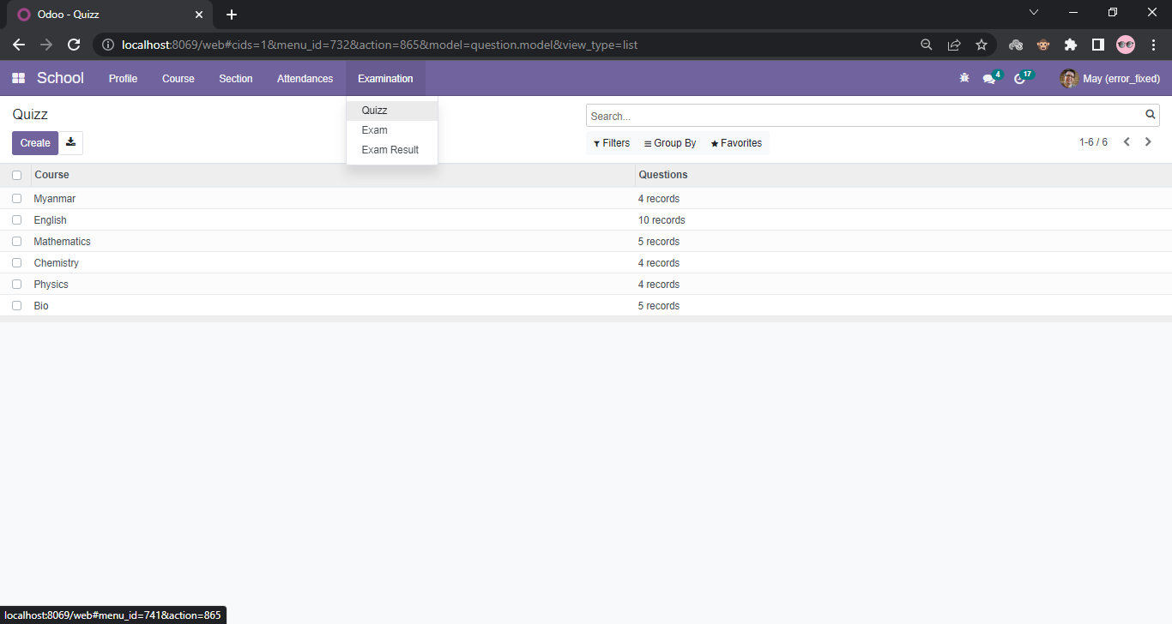
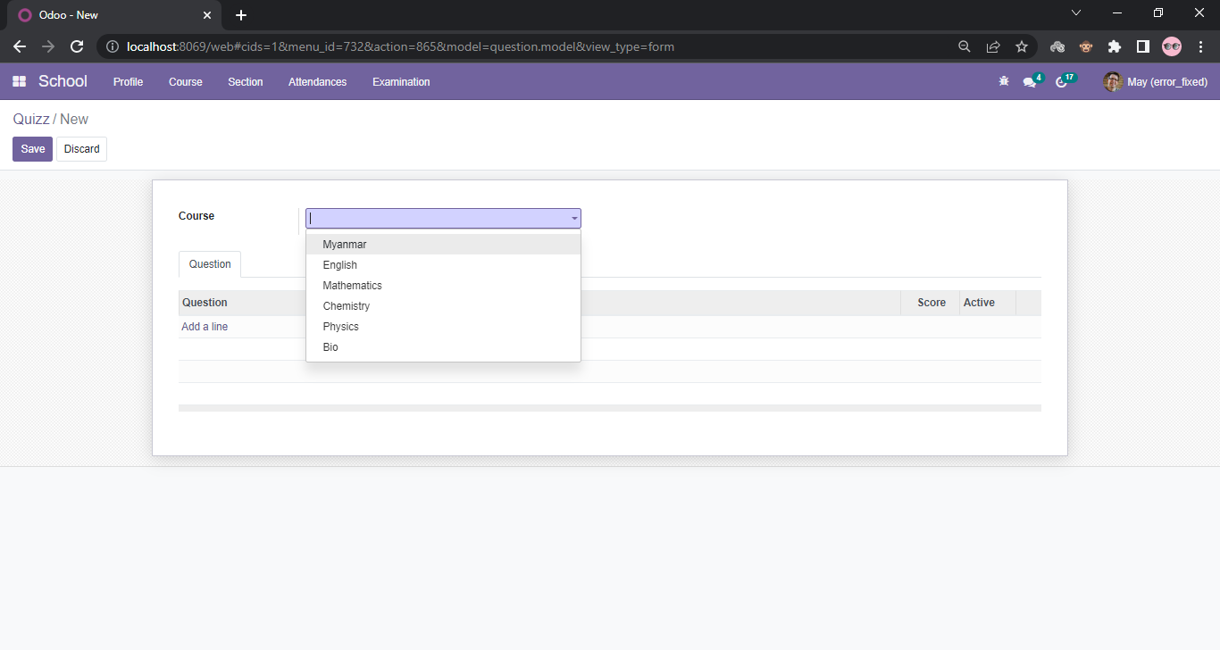
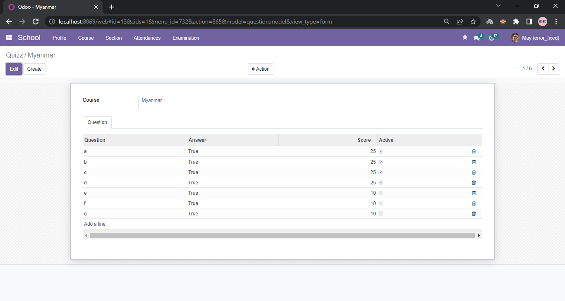
Cont’d
Create Exam Question for Teacher

Slide 19
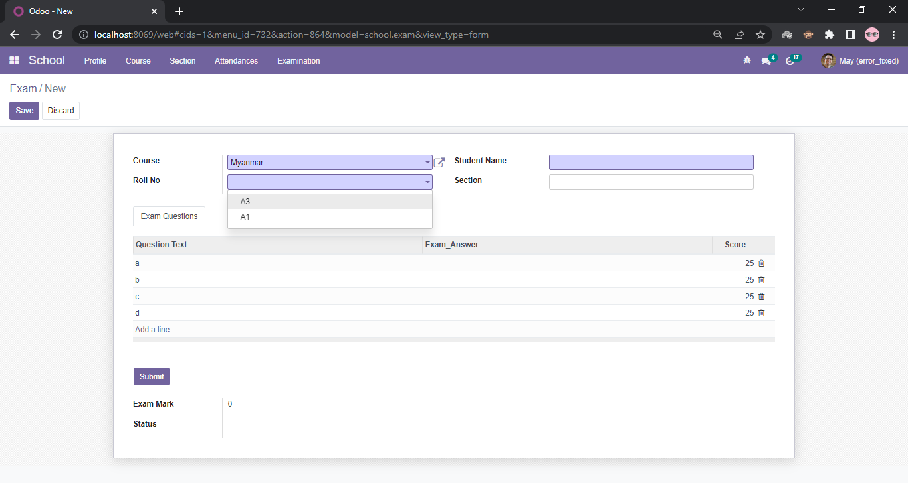
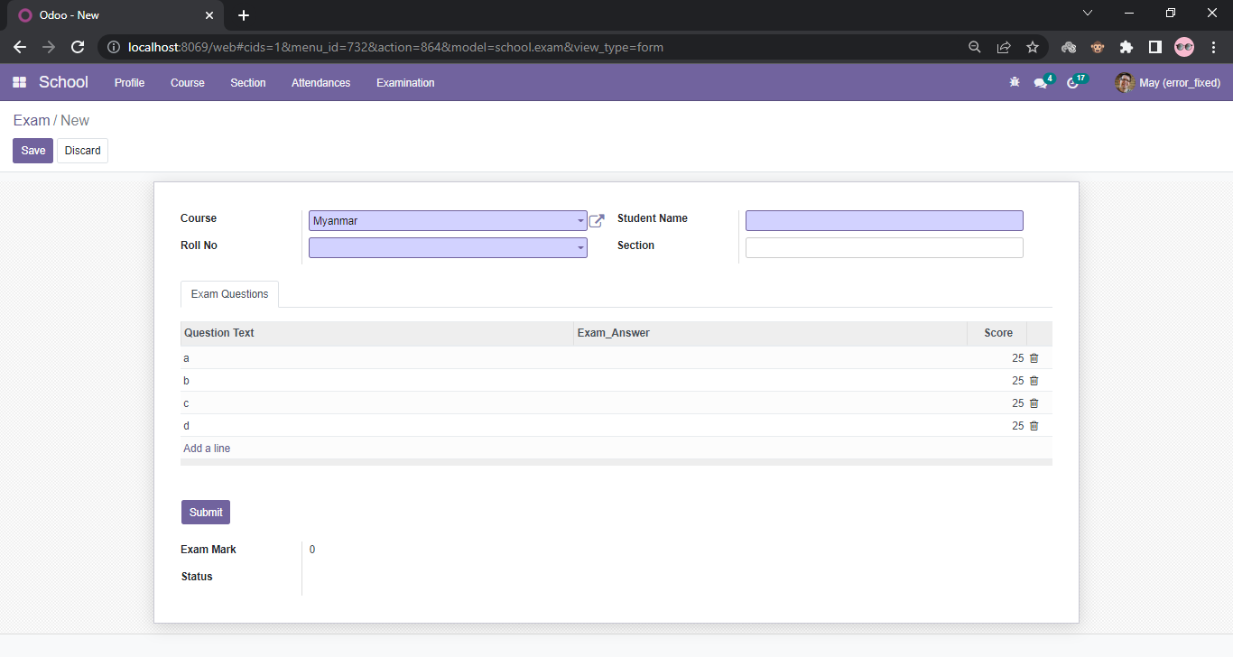
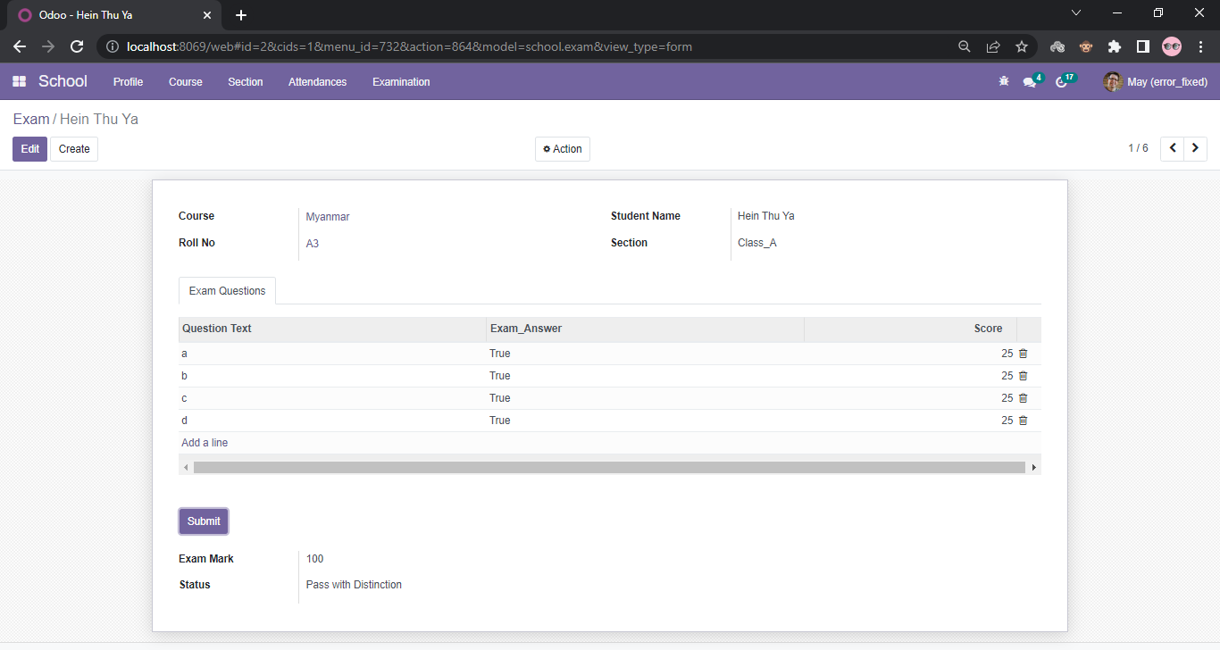
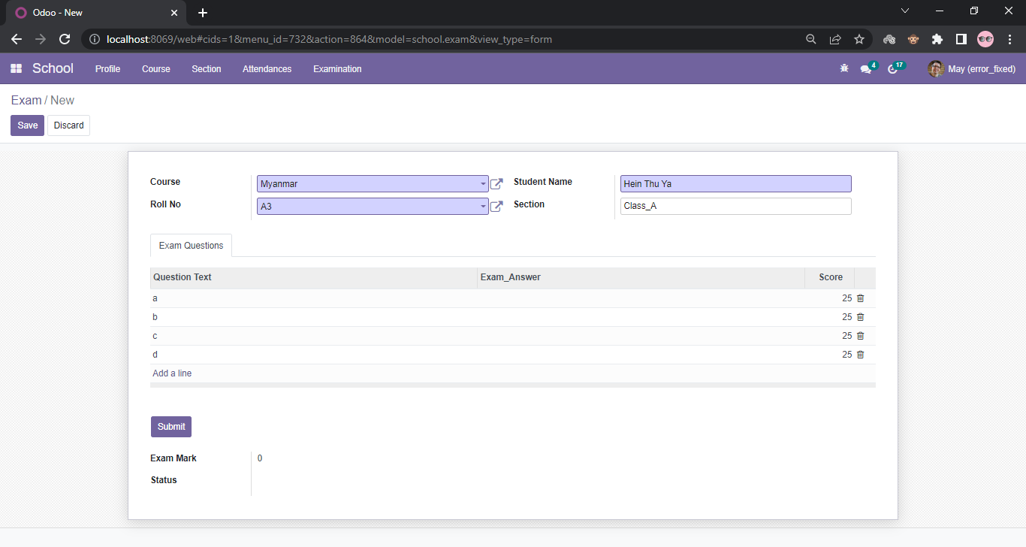

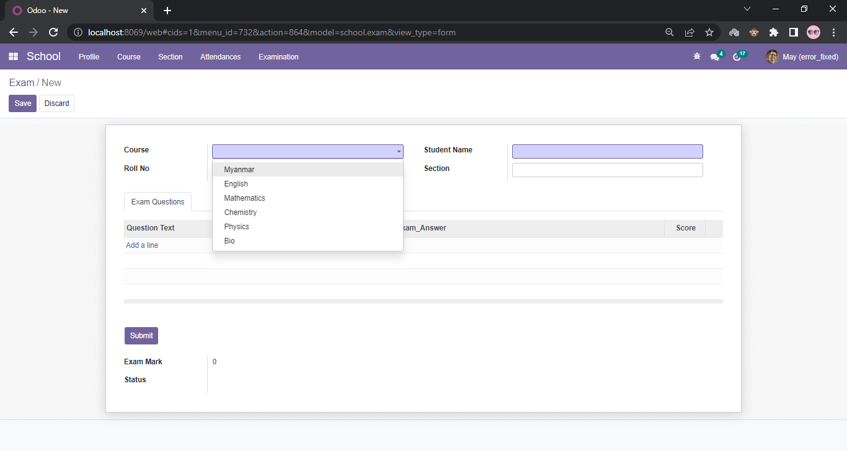
Cont’d
Create Exam for Student with Total Attendance is 80%

Slide 20
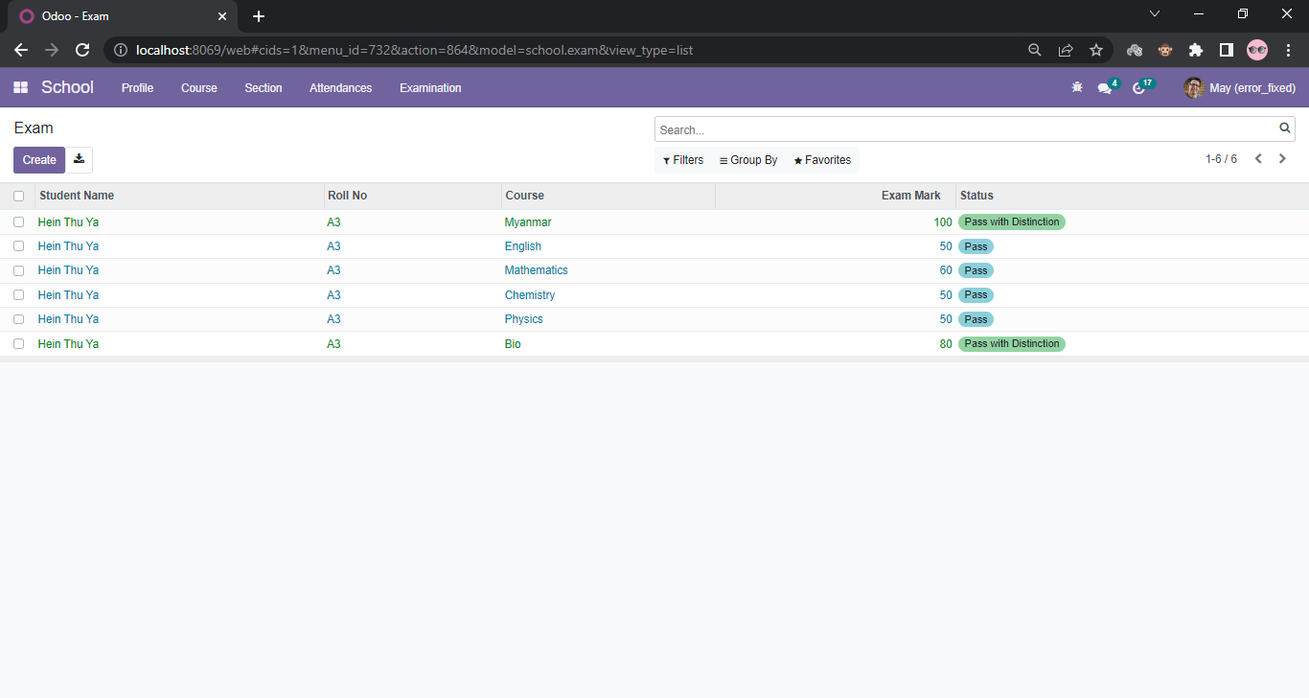
Cont’d
To Check Result for each subject

Slide 21
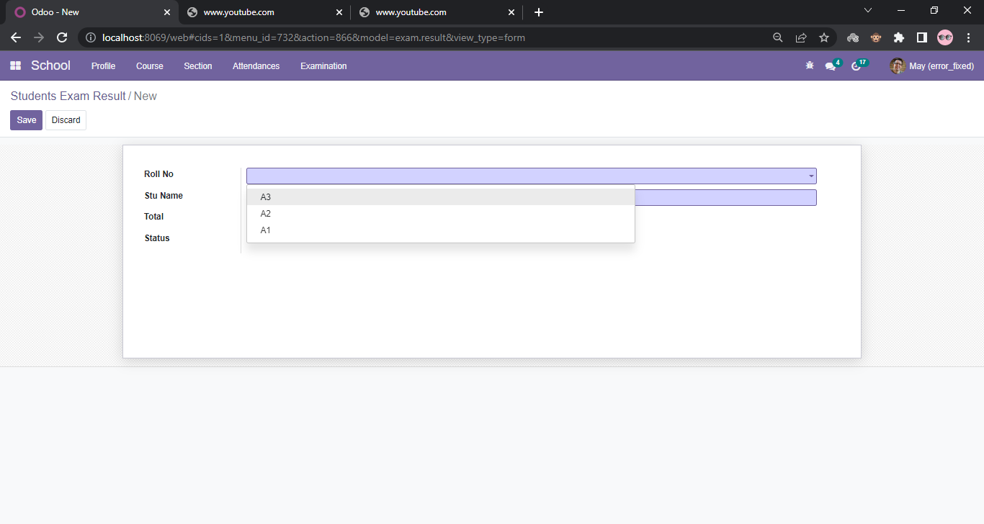
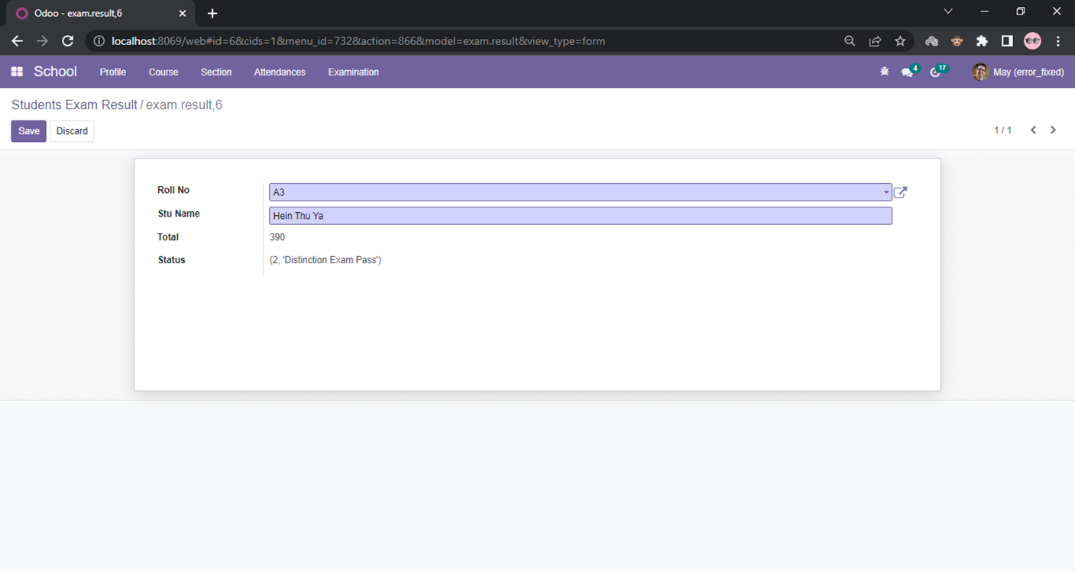
Cont’d
To Check Total Exam Result for each student

Slide 22
Conclusion
In Conclusion, this System can be used by educational institutions to maintain their student records easily.
Achieving this objective is difficult using the manual system as the information is scattered, can be redundant, and collecting relevant information may be very time-consuming.
All these problems are solved by this project.
This system helps in maintaining the information of student and teacher organization.
It can be easily accessed and kept safe for a long period of time without any changes.

Slide 23
THANK YOU
Insert the Subtitle of Your Presentation

